Slide 1


Profit Prediction Using Regression
Internship Project – Exposys Data Labs
Domain: Data Science
Name: Vedant Mishra
Roll No: 241030437
Batch: 24A11
Duration: 1 Month

Slide 2

Introduction: Forecasting Business Profit
This project focuses on predicting a company's profit based on key spending areas:
R&D Spend
Administration Costs
Marketing Spend
Utilizing machine learning, I built and evaluated multiple regression models to achieve accurate predictions. Tools used include Python, pandas, scikit-learn, Streamlit, and Tkinter.

Slide 3
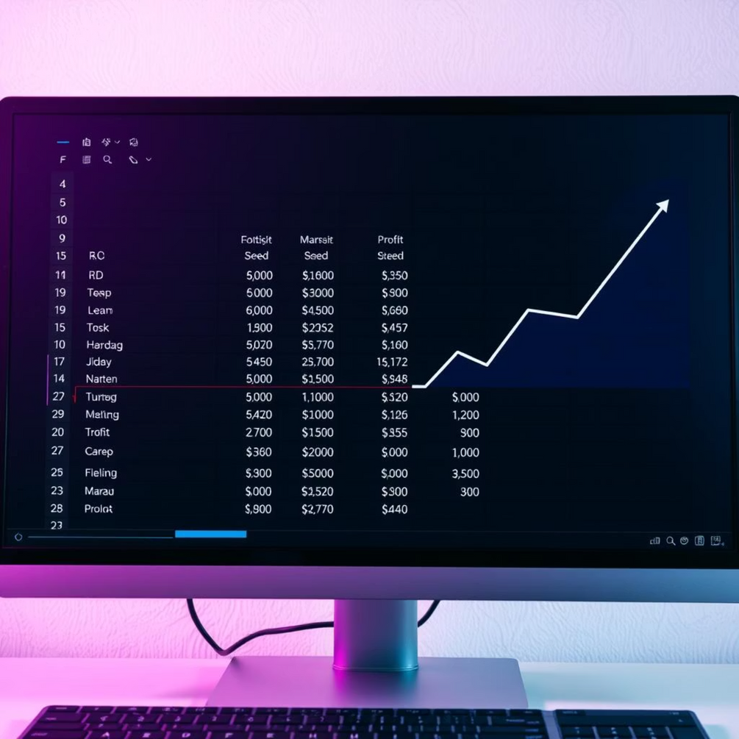
Dataset Overview: 50 Startups
Our analysis is based on the 50_Startups.csv dataset, comprising 50 records with 4 distinct columns:
R&D Spend: Expenditure on research and development initiatives.
Administration Cost: General administrative expenses.
Marketing Spend: Investment in marketing campaigns.
Profit (Target): The dependent variable for prediction.
All data points are numeric, and a crucial initial finding was the absence of missing values, ensuring data integrity for modeling.

Slide 4
Comprehensive Project Methodology
1. Data Preprocessing
Thorough cleaning and exploratory data analysis to understand data distribution and relationships.
2. Feature Visualization
Visualizing correlations between spending features and profit to identify key drivers.
3. Data Splitting
Dividing the dataset into training and testing sets to ensure robust model validation.
4. Model Training
Implementing Linear Regression, Decision Tree, and Random Forest models.
5. Performance Evaluation
Rigorous evaluation and comparative analysis of each model's predictive accuracy.

Slide 5
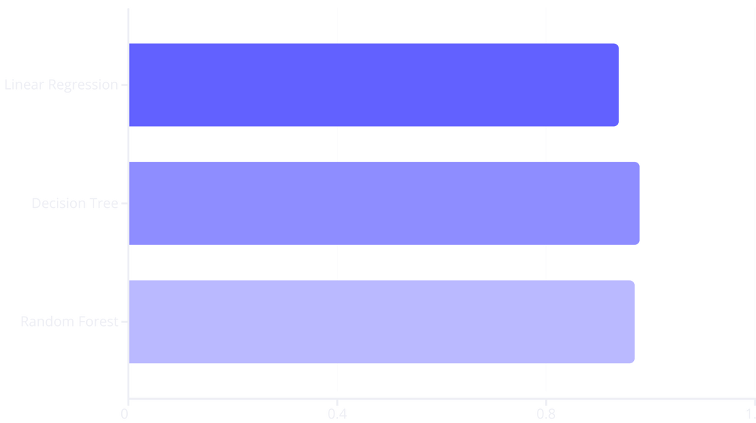
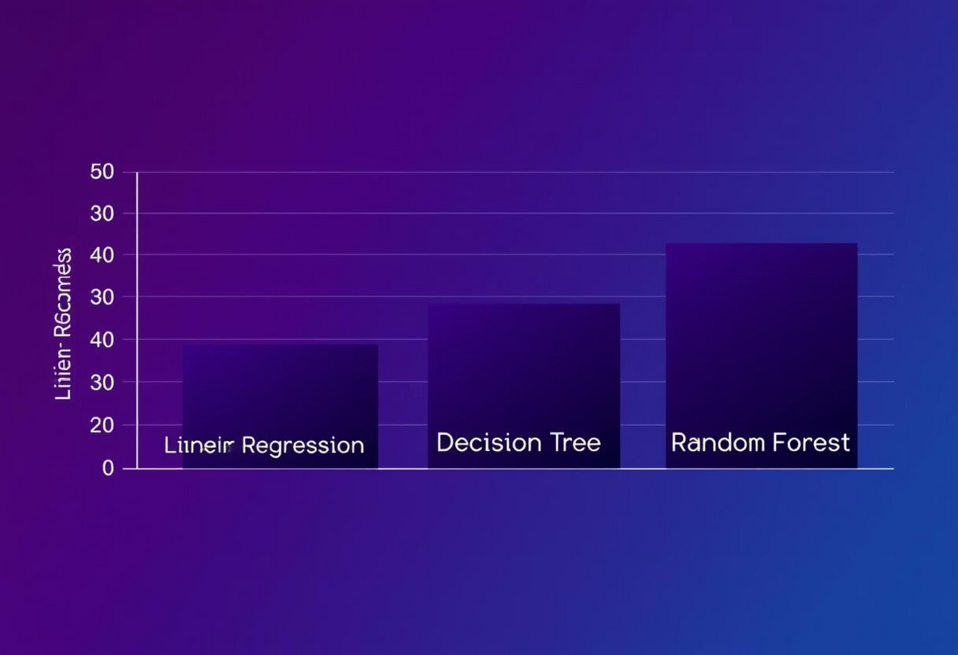
Model Performance: A Comparative Analysis
After training, we observed the following R² Scores for each model:
Linear Regression: 0.94
Decision Tree: 0.98
Random Forest: 0.97
The Decision Tree emerged as the superior model, demonstrating a slightly better fit on the unseen test data, indicating its strong predictive capability for profit forecasting.

Slide 6
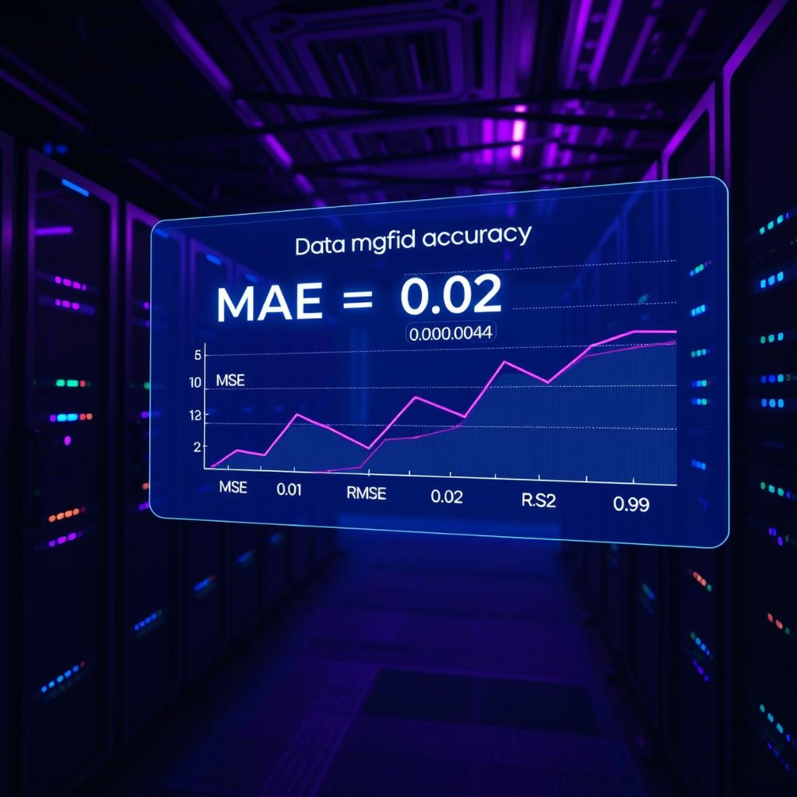
Detailed Evaluation of Random Forest Model
For a deeper insight into performance, we specifically analyzed the Random Forest model's metrics:
MAE (Mean Absolute Error): 5193
MSE (Mean Squared Error): 4,155,186
RMSE (Root Mean Squared Error): 6445
R² Score: 0.97
These robust metrics indicate that the model's predictions are remarkably close to the actual profit values, showcasing its high reliability and accuracy in forecasting financial outcomes.

Slide 7



User Interfaces for Profit Prediction
To enhance accessibility and usability, two distinct user interfaces were developed:
Desktop GUI (Tkinter)
A standalone application allowing users to input R&D, Administration, and Marketing spend, then instantly view the predicted profit.
Web Application (Streamlit)
A clean and responsive web interface, providing a user-friendly platform for profit prediction. Hosted locally via streamlit run app.py.

Slide 8

Conclusion: Empowering Business Decisions
Efficient Profit Prediction
Our model accurately predicts profit by leveraging historical spending data, providing valuable insights for future financial strategies.
Enhanced Usability
The deployment through both desktop GUI and a web application ensures broad accessibility and ease of use for various stakeholders.
Strategic Resource Optimization
This solution directly supports businesses in informed financial planning and optimal resource allocation, driving growth and efficiency.
✅ End of Presentation 📧 exposysdatalabs@gmail.com

